Slide 1
Predicting Protein-Protein Interactions and Networks Using Sequence and Structural Data
Shamima Akter, Maryam Alavi, Andrea Coronell, Weiru Han, Megan Mui, Pawan Thapaliya

Slide 2
Background
Protein-protein interactions (PPIs) are the driver of biological functions. By understanding PPIs, we can get a greater understanding of how biological pathways work, which is especially important in drug design for identifying protein targets or the synthesis of synthetic proteins.
less than 10% of all PPIs have been identified in model organisms
current experimental methods for determining PPIs are costly and time-consuming

Slide 3
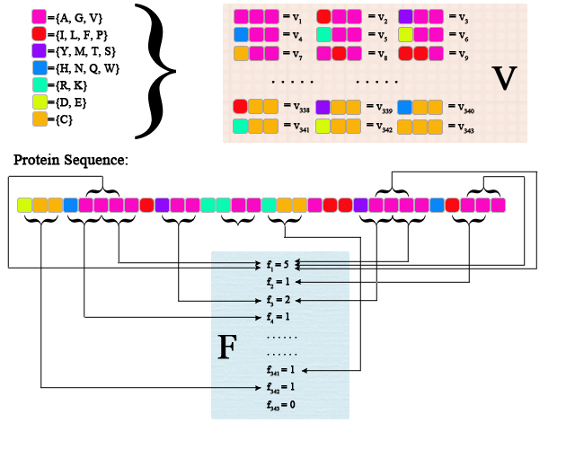
Predicting PPIs Using Sequence Data
proteins are composed of a string of amino acids which each have particular characteristics such as polarity, acidity, and size
building on a model described by Shen et al., sequences of binding and non-binding pairs of proteins were compared based on the dipoles and volumes of amino acid side chains
amino acids are evaluated in groups of threes, with similarly characterized amino acids being assumed to function similarly
I
K
N
=
L
K
H

Slide 4
Predicting PPIs Using Sequence Data
data of amino acid chains has to be standardized as otherwise larger proteins would have higher frequency of amino acid triads
frequency of triads for two proteins are concatenated into lists of 686 (343 permutations in each) for known binding and non-binding pairs and used to teach the computer
a separate list of known binding and non-binding pairs is then used to assess accuracy
The actual pipeline is as follows:
Use organism from homo sapiens, and fix protein as ARF5, extract 1440 protein pairs from STRING that has been indicated by multiple evidences that have strong interactions
To balance the labels, proteins with a size equal to the number of positive pairings are selected at random from the remaining proteins.
Each sequence consists of 20 types of amino acids, and each amino acid could be categorized into 7 classes. We use the number to represent the class labels from 1:7. By this way, we convert the sequence to the vector.
We use 3-units window to slide from the start of the sequence until the third position from last. For each window, we have 7*7*7 possible combinations. We create a frequency vector consists of 343 units, each of which represents the number of occurrence(s) within the sequence.
Since sequences are varied in terms of their, the frequency vector would be very different. We normalize the frequency vector using the probability ranging from 0 to 1.
Since the goal is obtain the feature space to predict the interaction between two proteins, we concatenate the normalized frequency vector whose length is 686.
Finally, we use the normalized feature vector in the multi-layer perceptron to predict the probability of interactions.

Slide 5
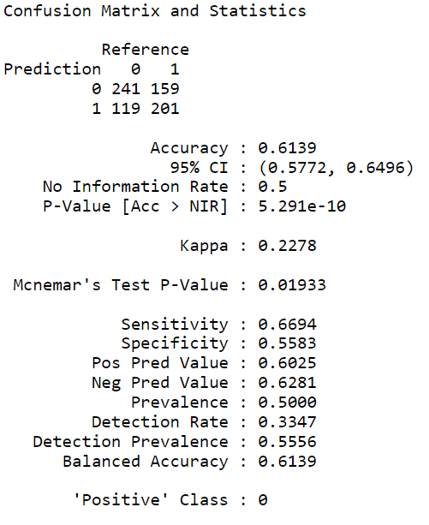
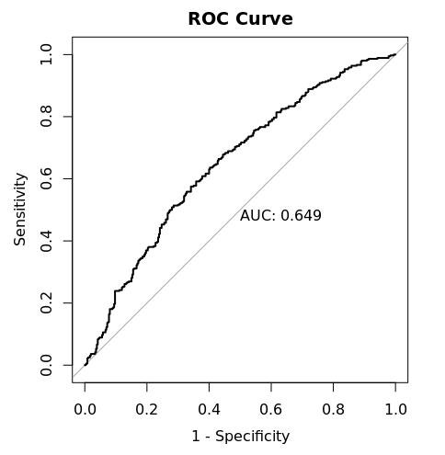
Results

Slide 6
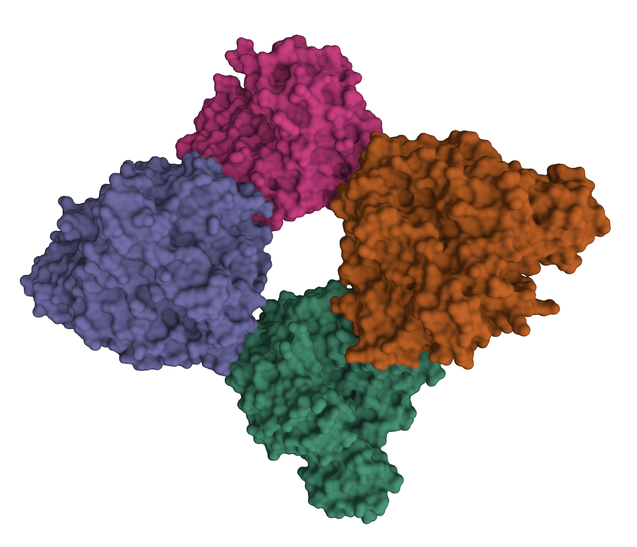
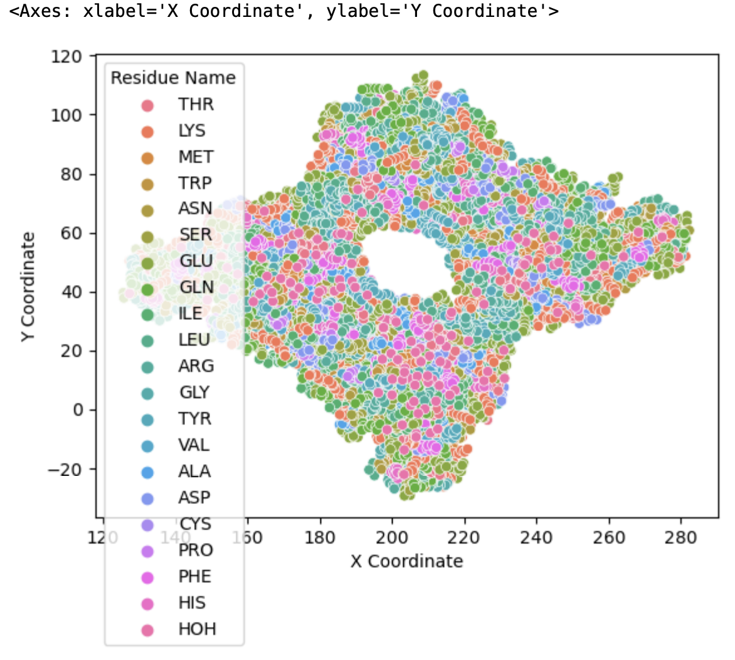
Predicting PPIs Using Structural Data
the overall structure of a protein can be plotted utilizing the coordinates of the atoms within amino acids
X, Y, and Z-coordinate features were used to assess binding between two known proteins by comparing the distance between protein residues

Slide 7
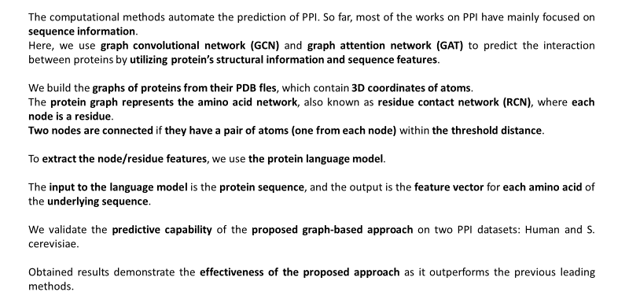

Slide 8
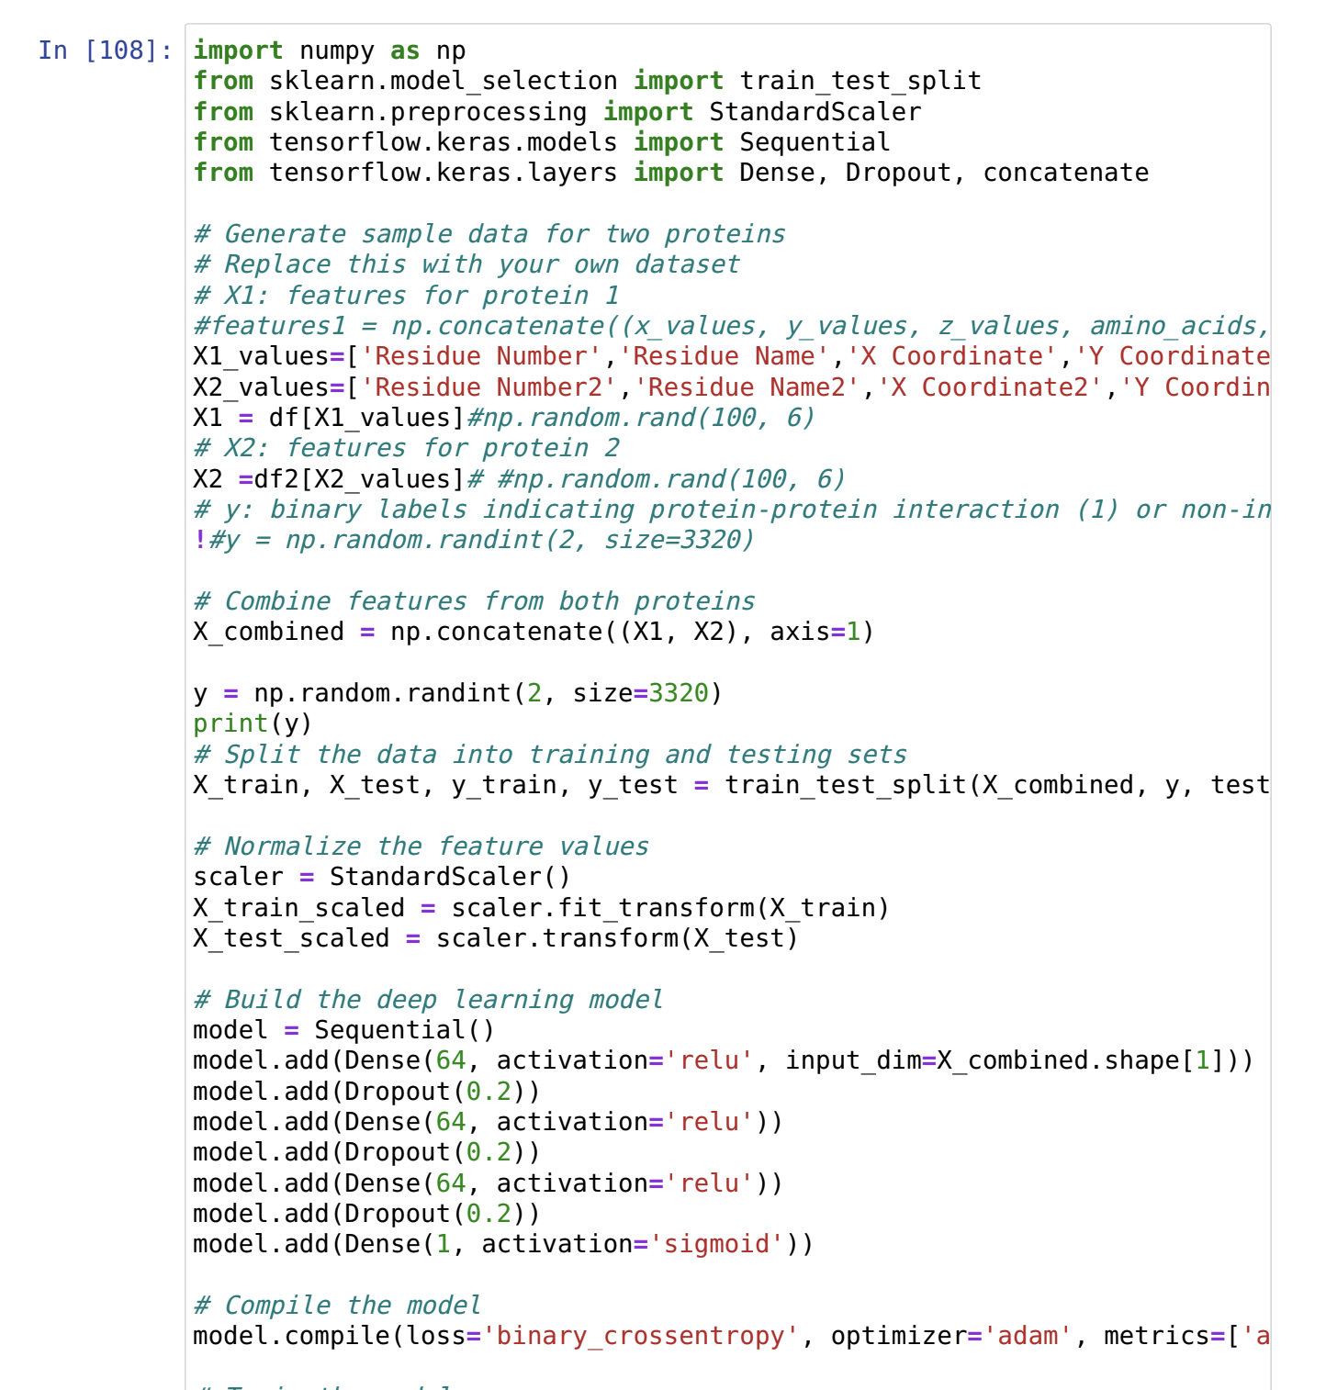

Slide 9
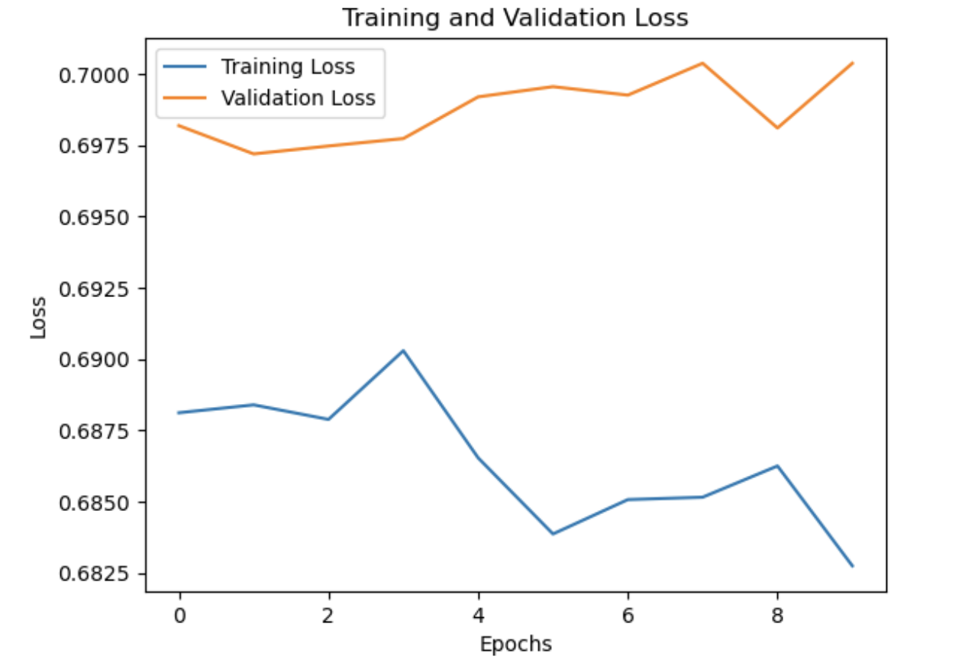
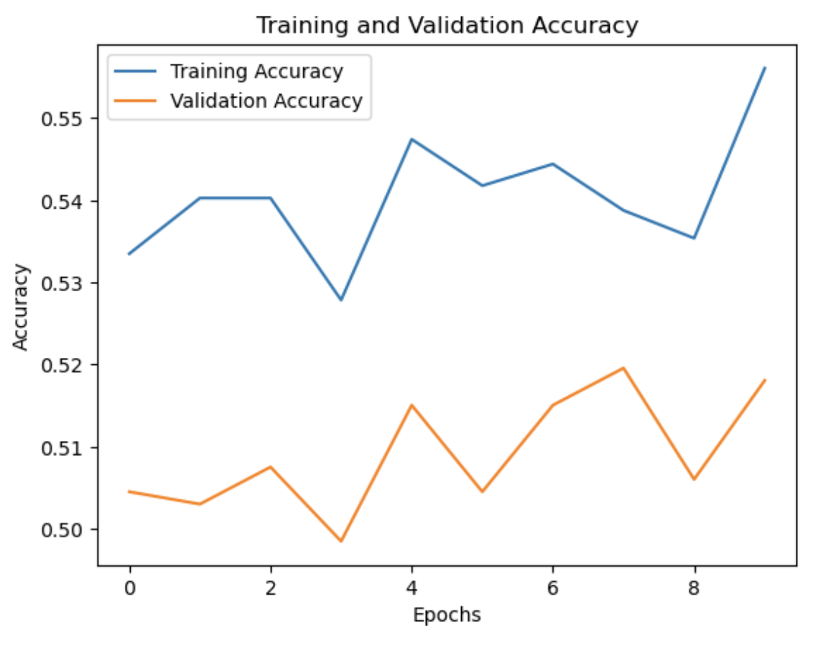
Predicting PPIs Using Structural Data

Slide 10
References
Jha, K., Saha, S. & Singh, H. Prediction of protein–protein interaction using graph neural networks. Sci Rep 12, 8360 (2022). https://doi.org/10.1038/s41598-022-12201-9

